Slide 1
WHeeLS
The driving teacher-student system .

Slide 2
Who are we ?!
Will , that won’t be hard to answer ☺
Our target is to limit the effort that the driving teacher and his students make in order to agree about there lessons hours together
How we do that ? , it’s simple and easy , the Teacher make his schedule as he want , and HIS students ( and only his students ) will have access to it . They will be able to choose the lesson they want if it’s free .
What about changes you ask ? Of course it possible , a Teacher can modify his schedule as he see right to do , he can cancel or add lessons if needed . Student can cancel lessons that he have already assigned to .
LETS HOW it’s DONE…

Slide 3
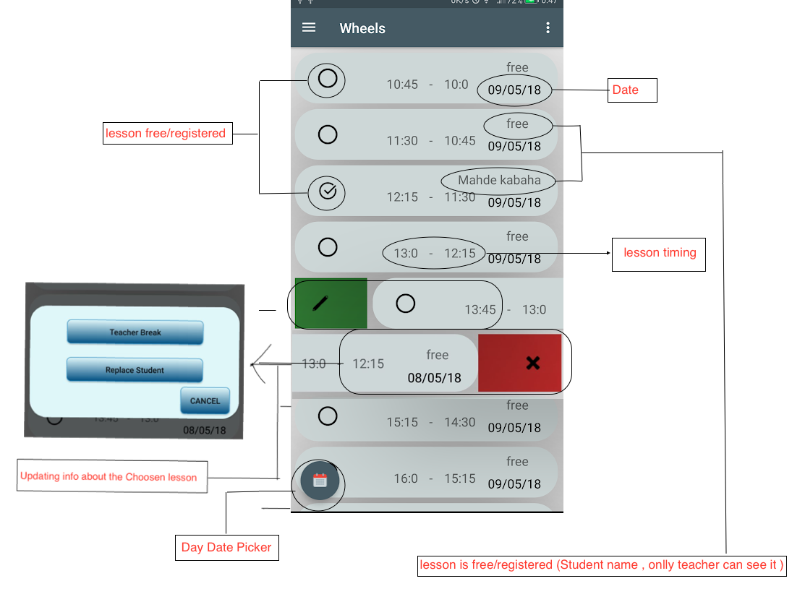
Teacher/Student Day
This is were the most work will be done .
As a Student You will be able to see the Free lessons and assign to one of them You may change it farther if you want .
as a Teacher , You will be able to see Your day schedule and how students pick there lessons , You may cancel Add Or replace lessons between Students
You may pick the date you want to look at by clicking the calendar icon down the screen

Slide 4
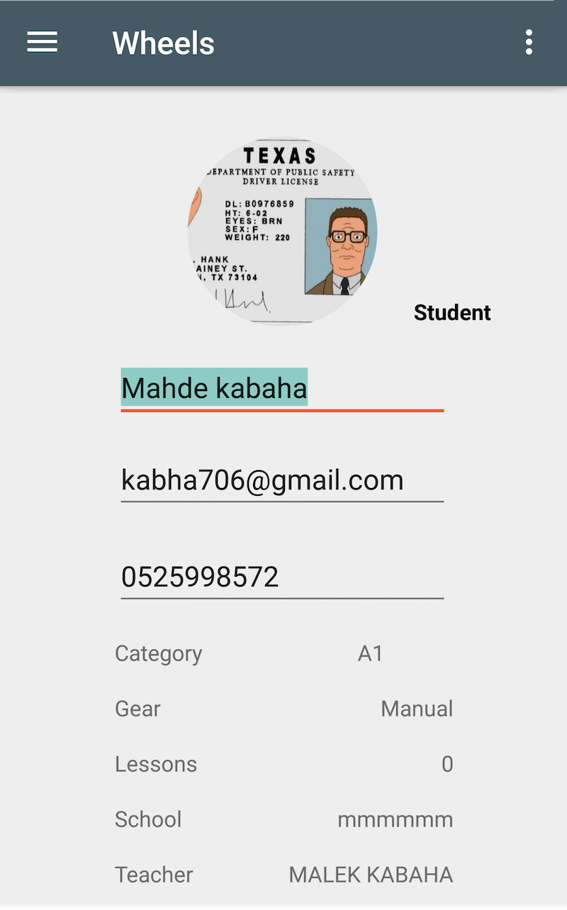
Profile
You may change Your personal details such as :
Profile picture
Name
Email
Phone number
License category
And even change the Teacher ( for Students )

Slide 5
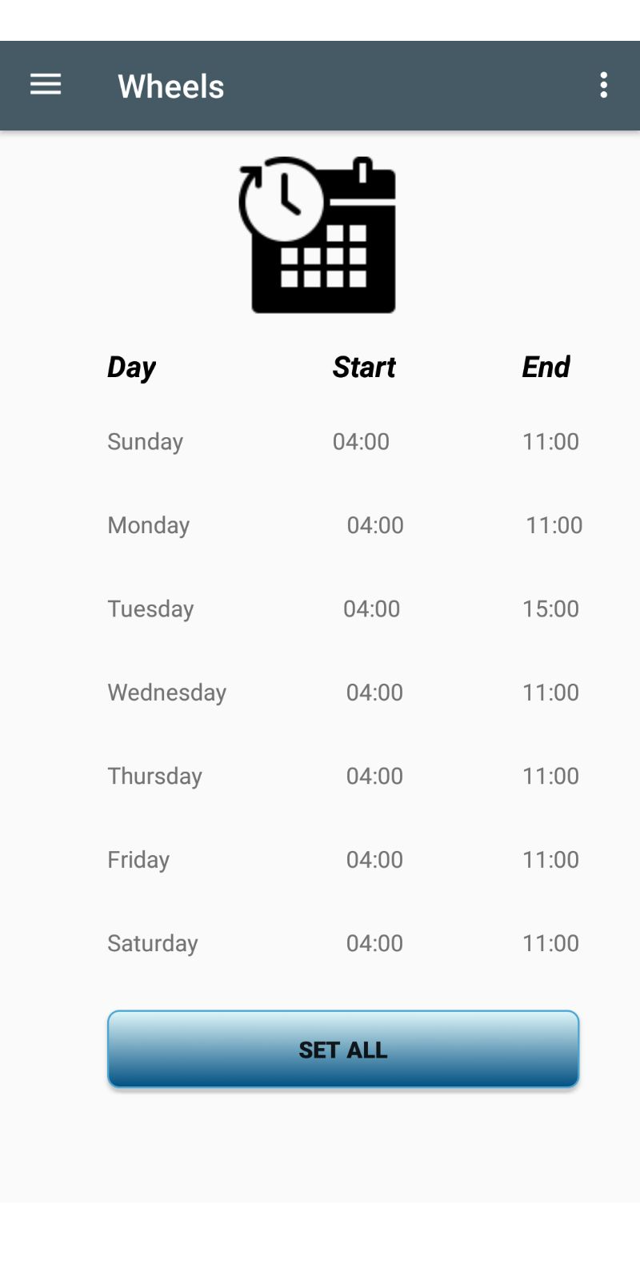
Teacher Schedule
Fill Your schedule as You want .
You have the ability to SET All days with one click .
You may change it when ever you want .

